Slide 1
Assignment 6 Performance Specs
Nusair Islam

Slide 2
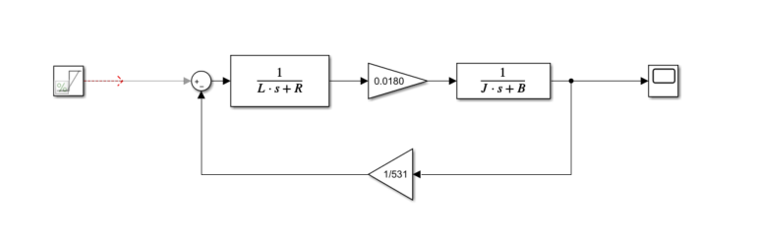
1 and 2. Develop Simulink model of Maxim Motor and find calculated vs datasheet %err
Nominal V = 12V
Terminal R = 19.2 Ohm
Km = 18.0 mNm/A
Kb = 531 rpm/V
Rotor Inertia = 1.03gcm³
Terminal L = 0.581mH
No load angular velocity = 6260 rpm
No load current = 11mA
Bearing resistance (B) = 3.163*10⁻⁸ Nm/rpm
Mechanical time constant = 6.67 ms
FV angular velocity = 6094 rpm
% err = 2.652%
FV current = 11mA
% err = 0%
FV Mech time constant = 57.6ms
% err = 764% (I’m not sure why my time constant is so off)

Slide 3
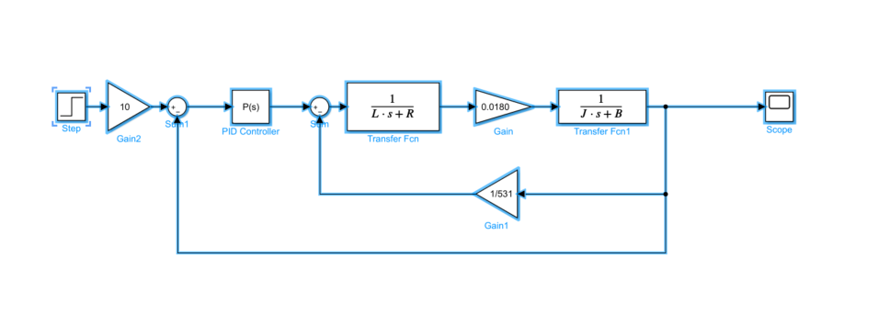
Part 3

Slide 4
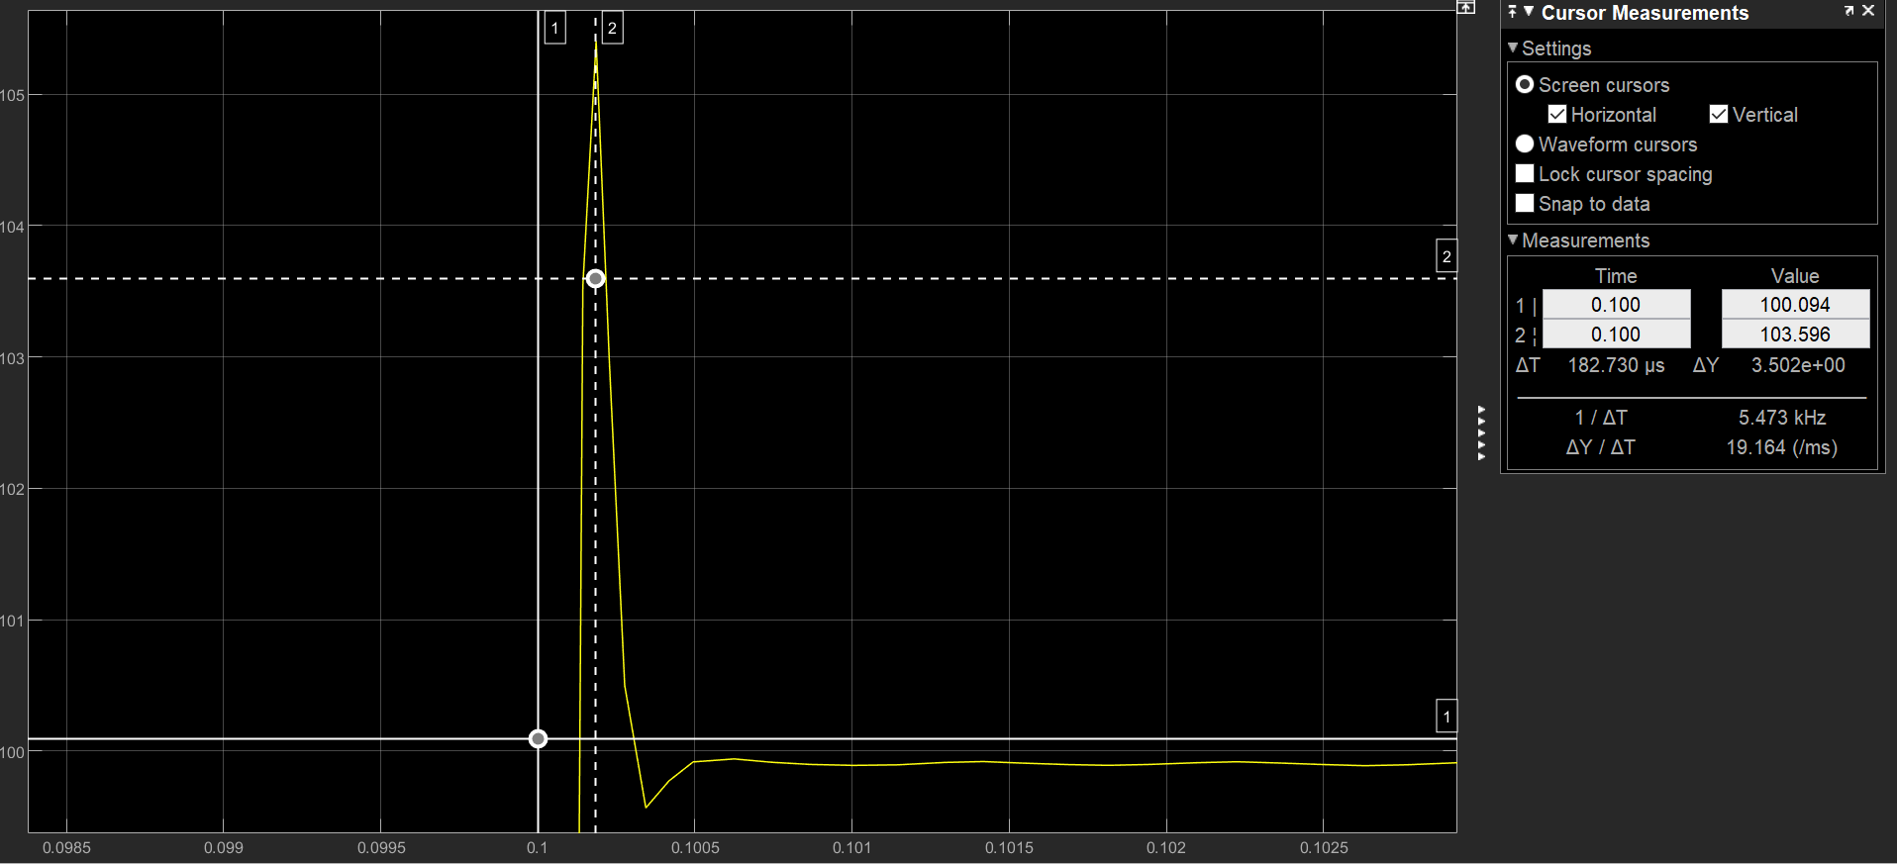
Part 4 and 6
Setting my P(s) controller to be a gain of 2, I have an OS of around 6%
Tpeak = 182.7us
Trise = 132.3us
Tsteady state = 889.4us
%err = (99.883 – 100)/100 * 100% = 0.117%

Slide 5
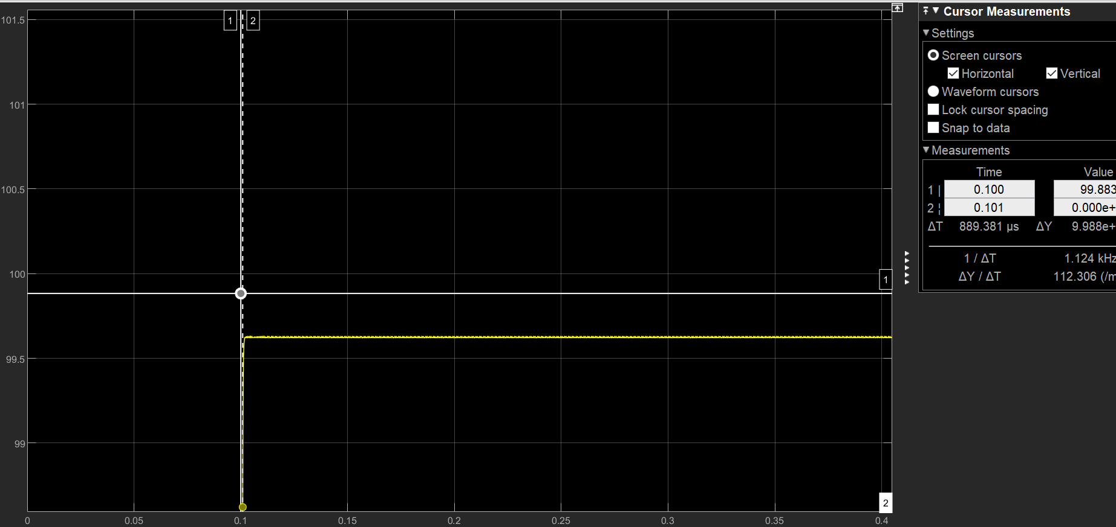
Part 5 and 6
Setting my P(s) controller to be a gain of 0.5, I have an OS of around 0%
Tpeak = 1.936ms
Trise = 1.936ms
Tsteady state = 1.936ms
%err = (99.964 – 100)/100 * 100% = 0.036%

Slide 6
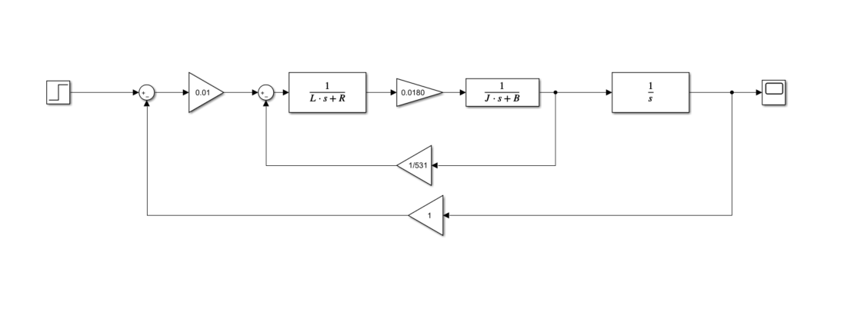
Part 7
I change my first gain block to create my necessary overshoots

Slide 7
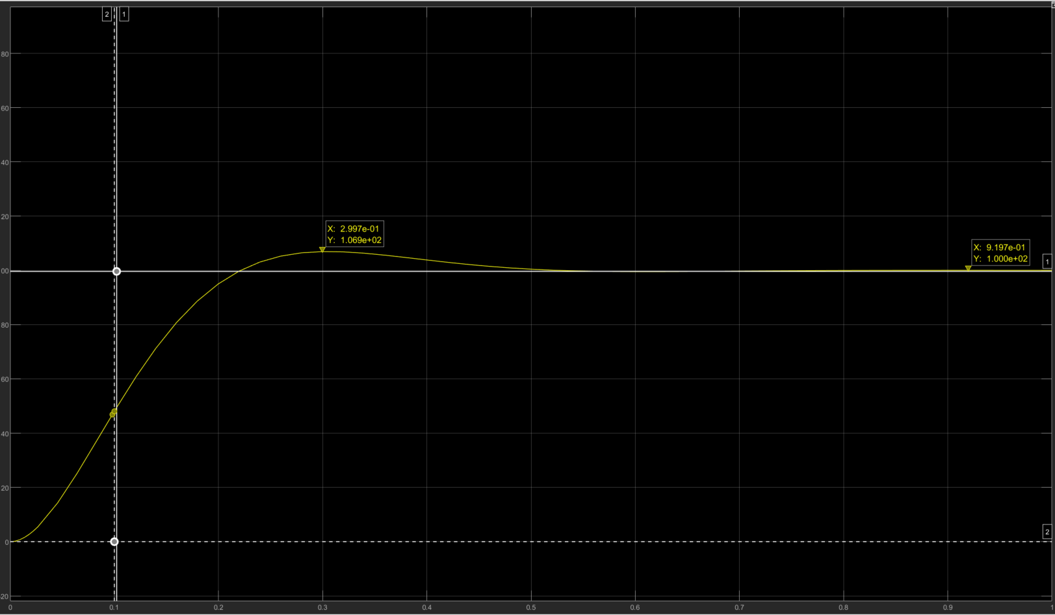
Part 7
Setting gain to 0.02, I got an %overshoot = 6.9%
Tpeak = 299.7ms
Trise = 218.2ms
Tsteady state = 555.5ms
% err = (100-99.624)/100*100% = 0.376%

Slide 8
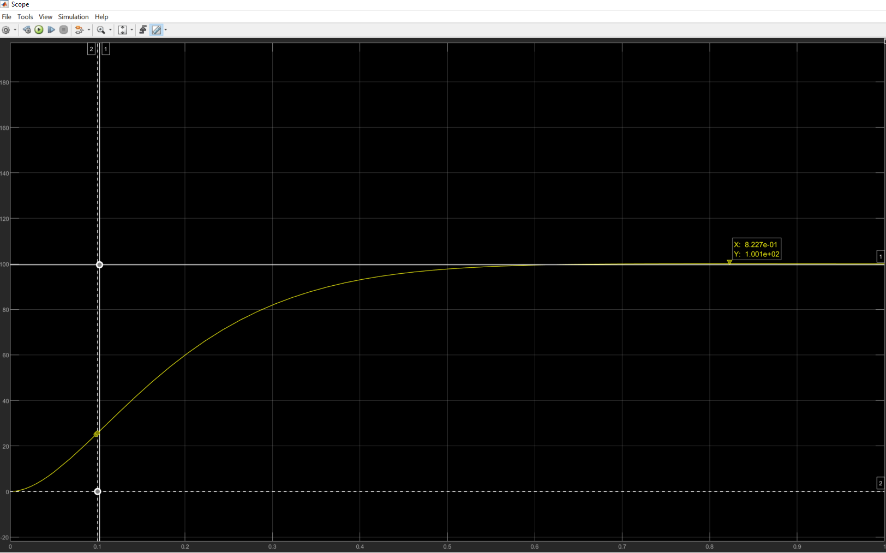
Part 7
Setting gain to 0.01, I got an %overshoot = 0%
Tpeak = 8.23ms
Trise = 8.23ms
Tsteady state = 8.23ms
% err = (100-100.1)/100*100% = 0.1%

Slide 9
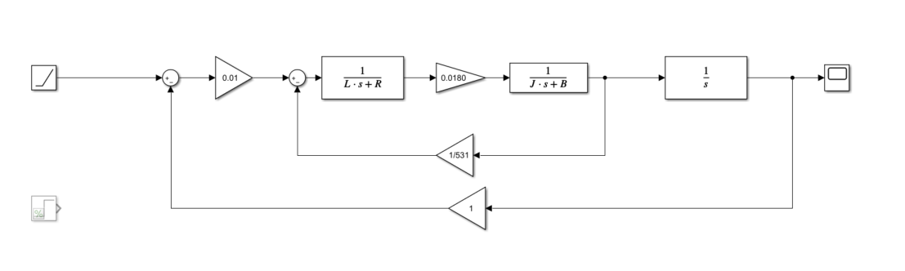
Part 8
This system has a ramp function and an additional step TF to convert angular speed to angle. If I wanted angle, I would remove the final step TF

Slide 10
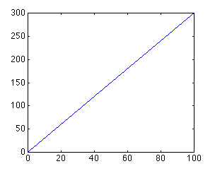
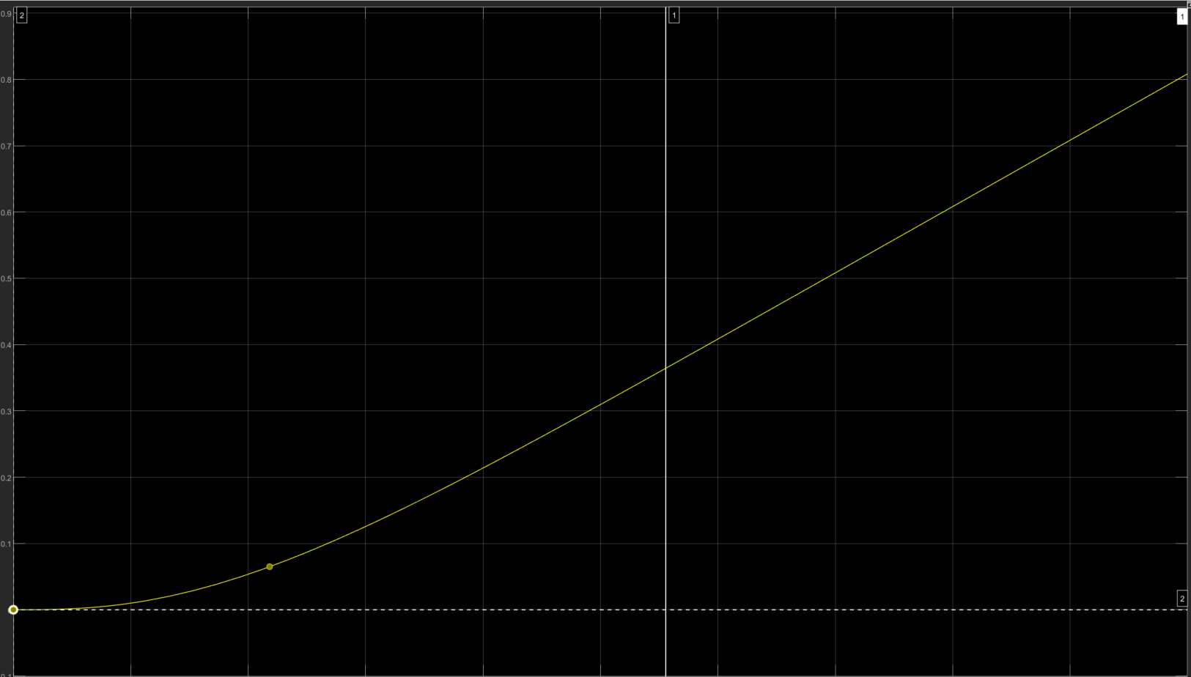
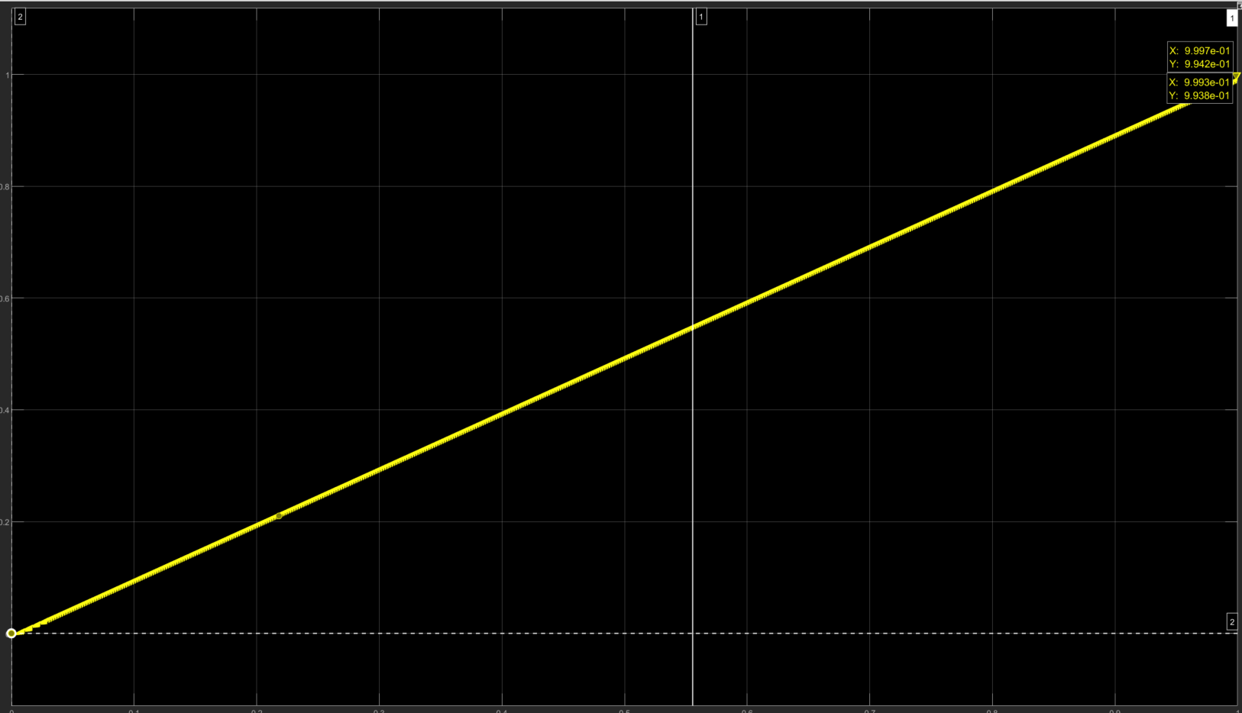
Part 8
This is the graph that we want, a fully linear graph
This is the angle graph we get; it is not fully linear in the beggining
This is the angular velocity graph we get; it has a lot of noise in it

